Slide 1
Minimum Spanning Trees
Parallel Formulations
(Prim's algorithm)
Parallel & Distributed Computing

Slide 2
Parallel & Distributed Computing
01
Minimum Spanning Tree
A spanning tree of an undirected graph G is a subgraph of G that is a tree containing all the vertices of G.
A minimum spanning tree (MST) for a weighted undirected graph is a spanning tree with minimum weight.
02
Parallel Formulation
Parallelization Prospects
Approach
03
Prim’s Algorithm
Cost to select the minimum entry
Broadcast next node selected for membership
Cost of locally updating d vector
Parallel time per iteration

Slide 3
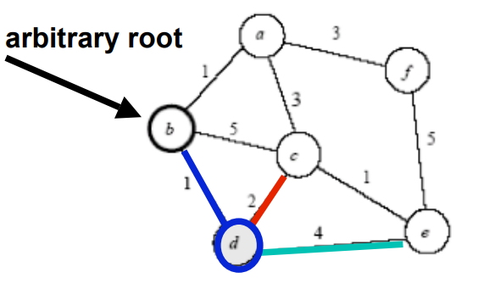
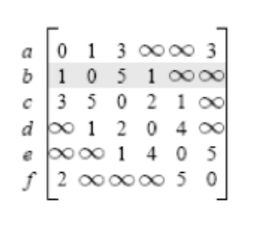
MST :Prims Algorithm
2 iterations

Slide 4
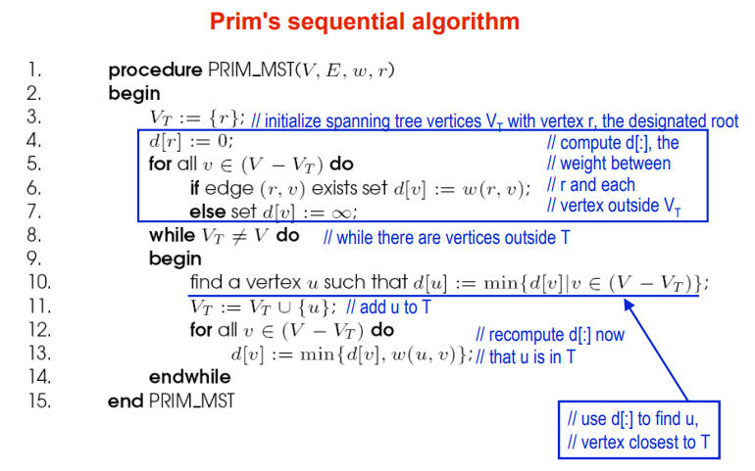
Steps
1
Randomly choose any vertex.
The vertex connecting to the edge having least weight is usually selected.
2
Find all the edges that connect the tree to new vertices.
Find the least weight edge among those edges and include it in the existing tree.
If including that edge creates a cycle, then reject that edge and look for the next least weight edge.
3
Keep repeating step-02 until all the vertices are included and Minimum Spanning Tree (MST) is obtained
Time Complexity
Worst case time complexity
O(ElogV) using binary heap
O(E + VlogV) using Fibonacci heap
You can simply impress your audience and add a unique zing and appeal to your Presentations. Easy to change colors, photos and Text. Get a modern PowerPoint Presentation that is beautifully designed. You can simply impress your audience and add a unique zing and appeal to your Presentations. Get a modern PowerPoint Presentation that is beautifully designed. You can simply impress your audience and add a unique zing and appeal to your Presentations. Easy to change colors, photos and Text.

Slide 5
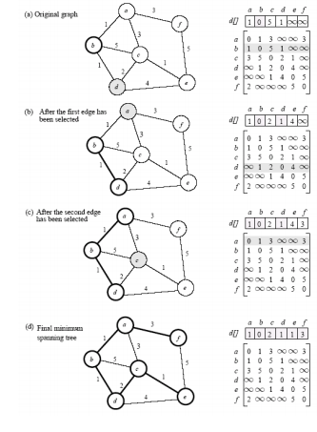
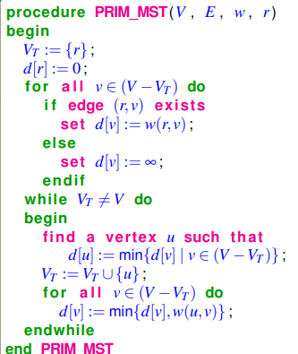
MST : Prim’s Algorithm
Prim’s algorithm for finding an MST is a greedy algorithm
• Start by selecting an arbitrary vertex, include it into the current MST
• Grow the current MST by inserting into it the vertex closest to one of the vertices already in current MST
Greedy Approach

Slide 6
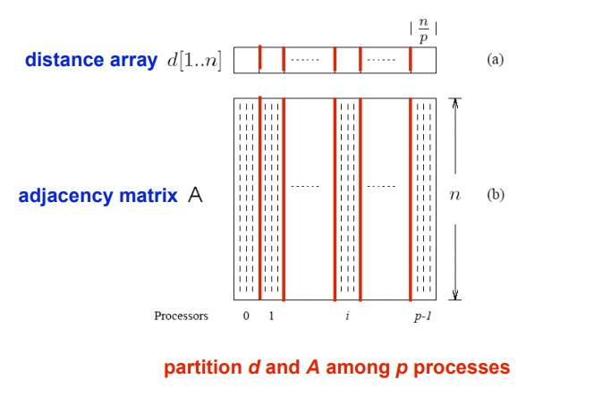
Parallel Formulation Of Prims Algo
Contents _ Graph
The algorithm works in n outer iterations
it is hard to execute these iterations concurrently.
The inner loop is relatively easy to parallelize.
Let p be the number of processes, and let n be the number of vertices.
The adjacency matrix is partitioned in a 1-D block fashion, with distance vector d partitioned accordingly.
In each step, a processor selects the locally closest node, followed by a global reduction to select globally closest node.
This node is inserted into MST, and the choice broadcast to all processors.
Each processor updates its part of the d vector locally..
Contents _ Graph
Example Text : Get a modern PowerPoint Presentation that is beautifully designed.
Contents _ Graph
Example Text : Get a modern PowerPoint Presentation that is beautifully designed.
TEXT
Add Your Text
Contents _ Graph
Example Text : Get a modern PowerPoint Presentation that is beautifully designed.
Contents _ Graph
Example Text : Get a modern PowerPoint Presentation that is beautifully designed.

Slide 7
Parallel Formulation
Parallelization prospects
Approach
outer loop (|V| iterations): hard to parallelize
– adding 2 vertices to tree concurrently is problematic
inner loop: relatively easy to parallelize
– consider which vertex is closest to MST in parallel.
data partitioning
– partition adjacency matrix in a 1-D block fashion (blocks of columns)
– partition distance vector d accordingly
In each step,
– process first identifies the locally closest node
– performs a global reduction to select globally closest node
– leader inserts node into MST
– broadcasts choice to all processes
– each process updates its part of d vector locally based on choice
MST : Prims Algorithm

Slide 8

Cost Complexity
Broadcast next node selected for membership
Cost to select the minimum entry
O(n/p): scan n/p local part of d vector on each processor
O(log p) all-to-one reduction across processors
Broadcast next node selected for membership
O(log p).
Cost analysis
Cost of locally updating d vector
Parallel time per iteration
Total parallel time
O(n/p): replace d vector with min of d vector and matrix row
O(n/p + log p)
O(n2/p + n log p)

Slide 9




Our Team Style
M Awais Zahid
Abu-Bakar
M Lal Ahsan
18F-0269
18F-0407
18F-0436
CS18-A
FAST NUCES.
CS18-A
FAST NUCES
CS18-A
FAST NUCES

Slide 10
THANK YOU
Parallel & Distributed Computing

